Slide 1
Using the Electronic Health Record (EHR) to Address LGBT Disparities in Primary Care
Harvey Makadon MD
October 6, 2016
www.lgbthealtheducation.org

Slide 2
Introduction
Lesbian, gay, bisexual, and transgender (LGBT) patients have unique health needs and experience numerous health disparities
They are an underserved population that is largely invisible in the health care system
Routine and standardized collection of sexual orientation and gender identity (SO/GI) information in electronic health records (EHRs) will help assess access, satisfaction with, quality of care, inform the delivery of appropriate health services, and begin to address health disparities
Notes:
A health disparity is…. “. . . a particular type of health difference that is closely linked with economic, social, or environmental disadvantage. Health disparities adversely affect groups of people who have systematically experienced greater social or economic obstacles to health based on their racial or ethnic group, religion, socioeconomic status, gender, age, or mental health; cognitive, sensory, or physical disability; sexual orientation or gender identity; geographic location; or other characteristics historically linked to discrimination or exclusion.” URL: http://www.healthypeople.gov/2020/about/disparitiesAbout .aspx
In this definition, economic disadvantage refers to lack of material resources and opportunities—for example, low income or lack of wealth, and the consequent inability to purchase goods, services, and influence. Social disadvantage is a broader concept. While it includes economic disadvantage, it also refers more generally to someone’s relative position in a social pecking order—an order in which individuals or groups can be stratified by their economic resources, as well as by race, ethnicity, religion, gender, sexual orientation, and disability. These characteristics can influence how people are treated in a society. In the Healthy People definition, environmental disadvantage refers to residing in a neighborhood where there is concentrated poverty and/or the social disadvantages that often accompany it. Braveman, Public Health Reports, 2014, Supplement 2, Volume 129 5-8

Slide 3
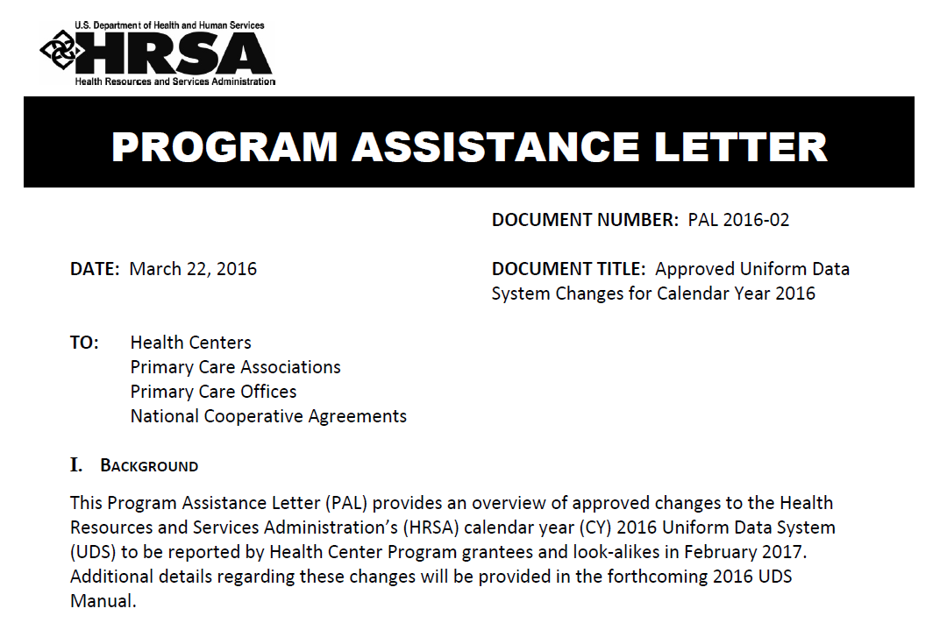

Slide 4
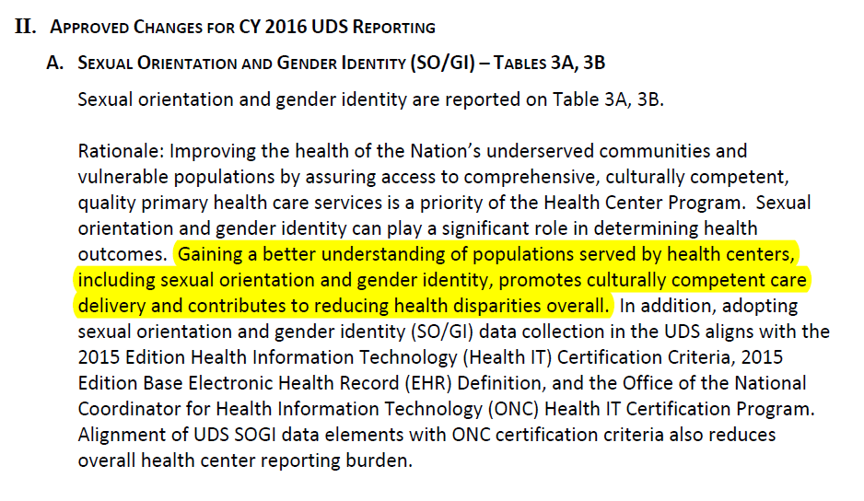

Slide 5
Table 3A: Sex Assigned at Birth

Slide 6
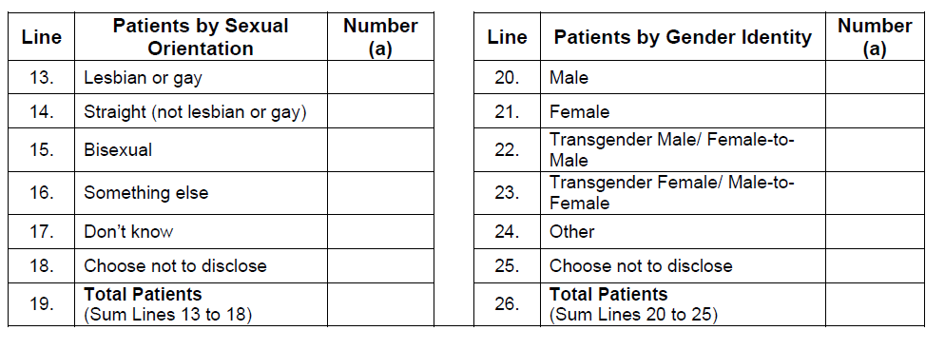

Slide 7
Why Programs for LGBT People

Slide 8
Stigma, Discrimination and Health
Stress/Anxiety/Depression
Health Disparities/Inequities
Interpersonal
Structural
Intrapersonal Stigma
Stigma
Hatzenbuehler, ML, Link, BG. 2014

Slide 9
Health Issues Throughout the Life Course
Childhood & Adolescence
Early & Middle Adulthood
Later Adulthood
Notes:
9

Slide 10
LGBT Disparities: Healthy People 2020
LGBT youth
2 to 3 times more likely to attempt suicide
More likely to be homeless (20-40% are LGBT)
Risk of HIV, STIs
MSM are at higher risk of HIV/STIs, especially among communities of color
LGBT populations have the highest rates of tobacco, alcohol, and other drug use
Lesbians and bisexual women are less likely to get preventive screenings for cancer
Notes:
LGBT youth may experience bullying from classmates and are at higher risk for social isolation and substance use. They can benefit from provider assessment of social functioning and may require increased social supports.
MSM and those at higher risk of HIV/STIs may require culturally responsive testing and prevention services (i.e. PEP and PrEP). MSM are at increased risk for anal cancer and anal cytology screenings should be considered for appropriate candidates.
Lesbians and other WSW are more likely to be overweight and obese compared to heterosexual and bisexual women (increases their risk for cardiovascular disease, lipid abnormalities, glucose intolerance). They are less likely than heterosexual women to receive cervical cancer screenings, even though their risk is similar. WSW over 40 years old are less likely to have had a mammogram compared to heterosexual women.
U.S. Department of Health and Human Services. (2014). Healthy People 2020. Lesbian, gay, bisexual and transgender health. Retrieved from http://www.healthypeople.gov/2020/topics-objectives/topic/lesbian-gay-bisexual-and-transgender-health?topicid=25

Slide 11
LGBT Disparities: Healthy People 2020
Transgender individuals experience
a high prevalence of HIV/STIs, hate crimes, behavioral health issues, and suicide,
difficult access to preventive and urgent care,
less likely to have health insurance than heterosexual or LGB individuals
Elderly LGBT individuals face additional barriers to health because of isolation, fewer family supports, and a lack of social and support services
Notes:
U.S. Department of Health and Human Services. (2014). Healthy People 2020. Lesbian, gay, bisexual and transgender health. Retrieved from http://www.healthypeople.gov/2020/topics-objectives/topic/lesbian-gay-bisexual-and-transgender-health?topicid=25

Slide 12
Understanding LGBT People
It is important for health care providers to understand who are LGBT people and to have a common understanding of terms and definitions
This allows for effective and respectful communication and the delivery of culturally competent care
Health care providers will be better equipped to serve their patients and LGBT communities
L,G,B,T people are a very diverse group with many unique issues, and many common bonds

Slide 13
SO/GI: The Basics

Slide 14
Sexual Orientation and Gender Identity are Not the Same
All people have a sexual orientation and gender identity
How people identify can change
Terminology varies
Gender Identity ≠ Sexual Orientation
Notes:
Sexual orientation and gender identity are distinct concepts. Everybody has a sexual orientation and a gender identity. A transgender person can be LGB or heterosexual. A lesbian, gay or bisexual person can be transgender or not transgender.

Slide 15
Sexual Orientation
Sexual orientation: how a person identifies their physical and emotional attraction to others
Desire
Same sex attraction
Behavior:
Men who have sex with men- MSM (MSMW)
Women who have sex with women-WSW (WSWM)
Identity:
Straight, gay, lesbian, bisexual, queer--other
Dimensions of Sexual Orientation:
Notes:
It can be useful to think about sexual orientation as being composed of three dimensions: identity, behavior, and attraction/desire. For most people, identity, behavior, and attraction/desire align (for example, a woman who is attracted to men, has sexual relationships with men, and identifies as straight). However, sometimes these dimensions do not align (for example, a man who identifies as straight, is married to a woman, but feels a strong attraction to men).

Slide 16
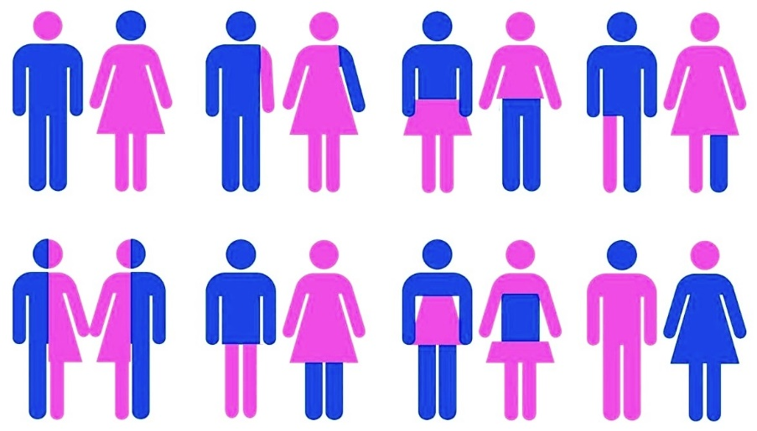
Gender Identity and Gender Expression
Gender identity
A person's internal sense of their gender (do I consider myself male, female, both, neither?)
All people have a gender identity
Gender expression
How one presents themselves through their behavior, mannerisms, speech patterns, dress, and hairstyles
May be on a spectrum
Notes:
See the Learning Guide for more definitions and a glossary of terms.

Slide 17
A 2013 community-based survey of 452 transgender adults in Massachusetts, 40.9% of respondents described themselves as having a “non-binary gender identity.
.
Keuroghlian AS, Resiner SL, White JM, Weiss RD. Substance use and treatment of substance use disorders in a community sample of transgender adults. Drug Alcohol Depen. 2015;152:139-146

Slide 18
The T in LGBT: Transgender
Transgender
Gender identity not congruent with the assigned sex at birth
Alternate terminology
Transgender woman, trans woman, male to female (MTF)
Transgender man, trans man, female to male (FTM)
Non-binary, genderqueer
Gender identity is increasingly described as being on a spectrum
Trans feminine, Trans masculine
Notes:
Additional Definitions:
Transgender man – someone who identifies as a man, but was assigned female sex at birth.
Transgender woman – someone who identifies as a woman, but was assigned male sex at birth.
Trans masculine – describes transgender people who were assigned female sex at birth, but identify with masculinity to a greater extent than femininity.
Trans feminine – describes transgender people who were assigned male sex at birth, but identify with femininity to a greater extent than masculinity.
See the Learning Guide for more definitions and a glossary of terms.

Slide 19
Collecting SO/GI Data in EHRs

Slide 20
Collecting SO/GI Information
www.lgbthealtheducation.org/topic/sogi/

Slide 21
Preparation for Collecting Data in Clinical Settings
Clinicians: Need to learn about LGBT health and the range of expression related to identity, behavior, and desire. Staff needs to understand concepts
Non-clinical staff: Front desk and patient registration staff must also receive training on LGBT health, communicating with LGBT patients, and achieving quality care with diverse patient populations
Patients: Need to learn about why it is important to communicate this information, and feel comfortable that it will be used appropriately
Notes:
SOGI data collection is critical, and has to be done sensitively without assumptions, routinely on all, along with other demographic data.

Slide 22
How to Ask SO/GI questions
There are various ways SO/GI information can be incorporated into the EHR and there is no single system to achieve this
SO/GI questions can be asked on registration forms in the demographics section
Providers ask SO/GI questions during patient visit
Answers can be entered into an EHR directly by a patient or member of the clinical staff, or transcribed at registration

Slide 23
Collecting SO/GI Information Prior to Arrival
Concept: Harvey Makadon, M.D. Created by: Komal Basra

Slide 24
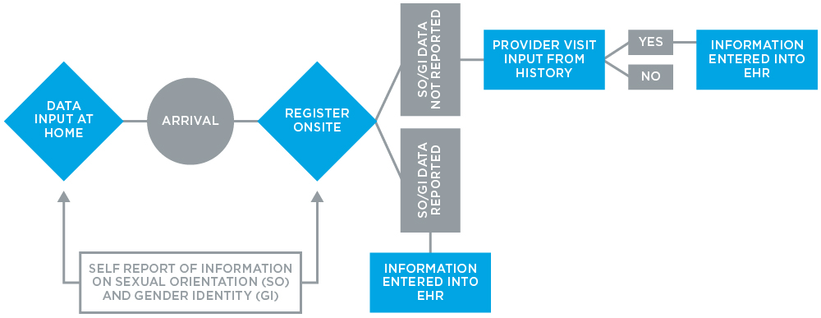
Asking SO/GI information on patient registration (intake) forms
Concept: Harvey Makadon, M.D. Created by: Komal Basra
Notes:
Collecting SOGI information during onsite registration is critical in order to ask routine and standardized SOGI questions that can then be directly entered into the EHR.

Slide 25
Collecting SO/GI Data During Onsite Registration
Patients should be asked standardized SO/GI questions as part of the demographic section on registration
Questions can be included alongside other demographic questions (i.e. race, ethnicity, language)
Patients should be informed that information will help health care providers to deliver appropriate prevention, screening, and treatment services
SOGI information should be updated as needed on an ongoing basis for both new and returning patients
Patients must be assured information will be kept confidential

Slide 26
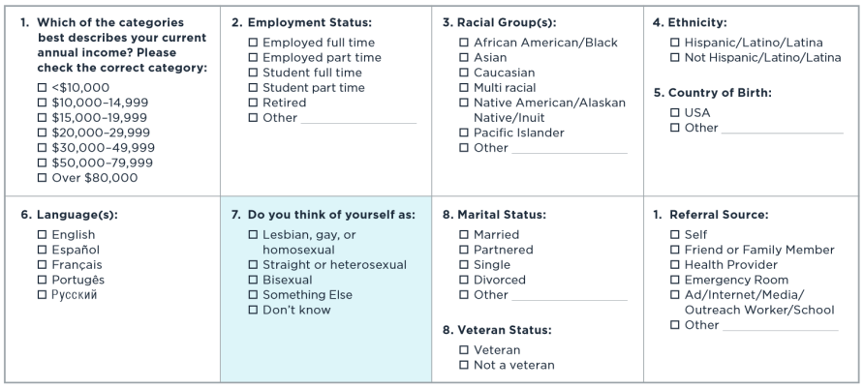
Collecting Demographic Data on Sexual Orientation (Example)
Notes:
Based on evaluations of acceptability and feasibility of collecting SOGI information in community health care settings conducted by the Fenway Institute and Center for American Progress and other studies evaluating how to ask SOGI questions, we recommend the following questions. Information would be entered into the EHR manually.
Cahill, S., Singal, R., Grasso, C., King, D., Mayer, K., Baker, K., & Makadon, H. (2014). Do Ask, Do Tell: High Levels of Acceptability by Patients of Routine Collection of Sexual Orientation and Gender Identity Data in Four Diverse American Community Health Centers. PLoS ONE, 9(9), e107104. http://doi.org/10.1371/journal.pone.0107104

Slide 27
Collecting Data on Gender Identity
What is your current gender identity?
Male
Female
Transgender Male/Trans Man/FTM
Transgender Female/Trans Woman/MTF
Gender Queer
Additional Category (please specify) _________
What sex were you assigned at birth?
Male
Female
Decline to Answer
What name do you use?
What are your pronouns (e.g. he/him, she/her, they/them)?
Notes:
The Gender Identity in U.S. Surveillance (GenIUSS) group, convened by the Williams Institute, is a collaborative effort between scientists, scholars, and transgender leaders working towards increasing knowledge about gender-related measurement and promoting the inclusion of these measures in population-based surveys. They report numerous tested and applied methods of how to collect gender identity information, including the 2-step method of assessing current gender identity and assigned sex at birth. The 2-step method was originally developed in 1997 by the Transgender Health Advocacy Coalition, a community-based organization, for use in a population survey in Philadelphia. The 2-step measure has since been adapted and endorsed by leading transgender health leaders and researchers, including the Center of Excellence for Transgender Health at the University of California at San Francisco (UCSF).
The Williams Institute. The GenIUSS Group. (2013). Gender-related measures overview. Retrieved from http://williamsinstitute.law.ucla.edu/wp-content/uploads/GenIUSS-Gender-related-Question-Overview.pdf
The Fenway Institute. Center for American Progress. (2013). Asking patients questions about sexual orientation and gender identity in clinical settings: A study in four health centers. Retrieved from http://thefenwayinstitute.org/wp-content/uploads/COM228_SOGI_CHARN_WhitePaper.pdf
Data conducted by Deutsch et al. (2013) have shown that this 2-step method is superior in identifying transgender patients compared to a previous 1-step question, with choices of male, female, or transgender. Identification of transgender patients can then lead to an appropriate discussion of anatomical inventory. This will help inform preventive screening services and provision of other health care services as indicated.
Deutsch, M. B., Green, J., Keatley, J., Mayer, G., Hastings, J., & Hall, A. M. (2013). Electronic medical records and the transgender patient: recommendations from the World Professional Association for Transgender Health EMR Working Group. Journal of the American Medical Informatics Association : JAMIA, 20(4), 700–3. http://doi.org/10.1136/amiajnl-2012-001472

Slide 28
Name Used and Pronouns
What name do you use?
What are your pronouns (e.g. he/him, she/her, they/them)?
It is important to ask patients to include the name they use and their pronouns on registration forms
Many transgender patients may have identification documents and insurance forms that do not reflect the name they use and gender identity
Some patients may have a non-binary gender identity and use pronouns such as “they” or “ze”, which may be unfamiliar to some providers

Slide 29
Asking SO/GI Questions During the Clinical Encounter
Concept: Harvey Makadon, M.D. Created by: Komal Basra

Slide 30
Directly Asking SO/GI Questions
If patients leave SO/GI questions unanswered on registration forms, health care providers should re-ask these questions during the clinical encounter
Sexual orientation, sexual behavior, gender identity, name and pronouns questions should be asked during the first clinical visit and on an ongoing basis as indicated

Slide 31
Gathering LGBT Data During the Process of Care
Concept: Harvey Makadon, M.D. Created by: Komal Basra
Notes:
SOGI data can be collected at several different points during and prior to the clinical encounter. SOGI information can be entered into the EHR directly by the patient prior to arrival at home. SOGI information can also be obtained during onsite registration on intake forms, as well as during the patient-physician clinical encounter.

Slide 32
Beyond Data Collection: Systems that Facilitate Getting it Right: Decision Support and Coding

Slide 33
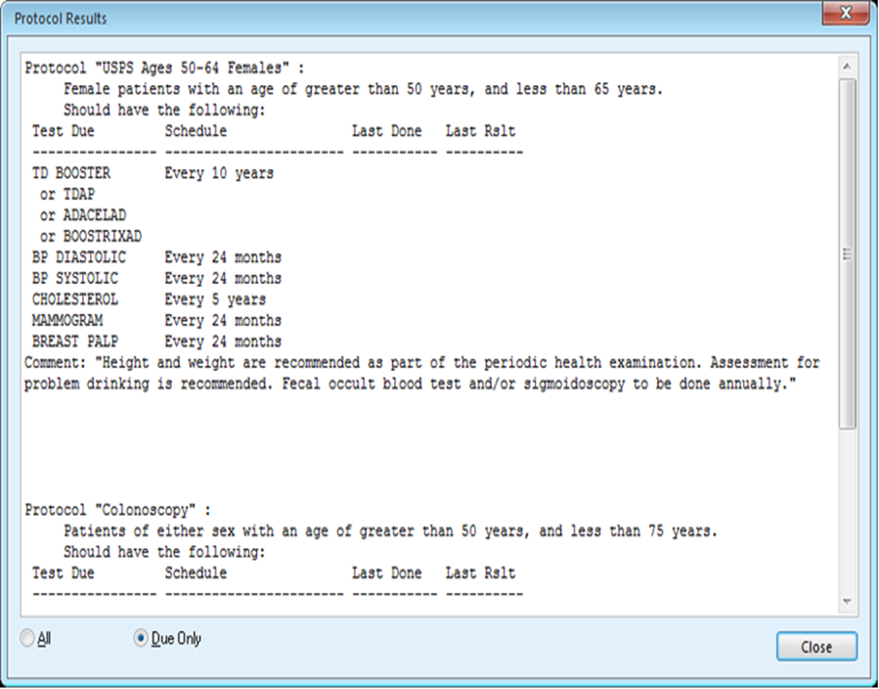
Decision Support
Decision support in the form of alerts and reminders must be built into the EHR system in order to remind providers to conduct indicated preventive screenings

Slide 34
Transgender Patients: Organs for Inventory
It is important for clinicians to maintain an up-to-date anatomical inventory, which will direct any indicated preventive screenings
Notes:
HCPs can also discuss history of gender affirming treatments and procedures. The following is a list of common treatments and procedures for transgender patients.
Cross-sex hormone therapy, current user
Cross-sex hormone therapy, past user
Vaginoplasty, penile inversion
Vaginoplasty, colon graft
Phalloplasty, abdominal flap
Phalloplasty, free flap
Metoidioplasty
Scrotoplasty
Urethroplasty
Scalp advancement
Forehead reconstruction
Reduction thyrochondroplasty
Laryngeal feminization surgery
Soft tissue filler injections
Bilateral total reduction mammoplasty
Voice surgery
Other unlisted surgical procedures
Deutsch, M.B., Green, J. Keatley, J. Mayer, G. Hastings, J., Hall, A.M. (2013). Electronic medical records and the transgender patient: Recommendations from the World Professional Association for Transgender Health EMR Working Group. J Am Med, 20, 700-703

Slide 35
Coding and Reimbursement

Slide 36
Transgender Health and Coding
A transgender man may be registered in the EHR system under a male name and gender
If the patient has a cervix, uterus, and ovaries, providers will require the ability to enter gynecological history and pelvic physical exam findings
May need to order a Pap test through the EHR system
EHR templates that use pre-populated fields may prevent providers from entering a gynecological history and physical exam findings
This ultimately may create billing difficulties and a failure to be reimbursed for the provision of indicated health services
Notes:
It is therefore critical for EHR templates and data collection fields to be based on an up-to-date anatomical inventory for transgender patients in order to accurately document and provide appropriate care to transgender patients.

Slide 37
Addressing Coding and Reimbursement Issues
Adequate EHR coding mechanisms must be in place to accurately document LGBT health information and bill for health services
Must engage health insurance providers about LGBT standards of care
Necessary so that indicated health services are routinely covered by insurance providers
Can use of Z codes be promoted to indicate a reason for a visit and care without giving a psychiatric or medical diagnosis, e.g., counseling to support gender identity

Slide 38
Creating a Welcoming and Inclusive Environment for Caring, Working and Learning

Slide 39
Avoiding Assumptions
You cannot assume someone’s gender or sexual orientation based on how they look or sound
To avoid assuming gender or sexual orientation with new patients:
Instead of: “How may I help you, sir?”
Say: “How may I help you?”
Instead of: “He is here for his appointment.”
Say: “The patient is here in the waiting room.”
Instead of: “Do you have a wife?”
Say: “Are you in a relationship?
Instead of:” What are your mother and fathers’ names?”
Say: “What are your parents’ names.”

Slide 40
Do Ask, Do Tell: Talking to your provider about being LGBT

Slide 41
Where the rubber meets the road: Our experiences

Slide 42
Feeling Stuck with your EHR?
Notes:
EHR Vendor has not released an update
EHR does not have fields in the registration section

Slide 43
Short Term Solutions for Data Capture
Begin data collection on paper and enter when fields are available
Enter in a different field in your EHR
Create fields in your EHR
Create custom form/template in you EHR
Utilize EHR knowledgebase (customer information sharing)
Begin capturing through your portal

Slide 44
Starting the Process
Create your Team
Include key staff who can be champions and provide feedback
Management/Department Directors, Clinical Staff, Non-Clinical Staff, HIT Staff
Senior Management Support
Training
Clinical Staff (e.g. MD, Medical Assistants, Nurses, Optometrists, Dentists)
Non-Clinical staff (e.g. Front desk/Patient Services, Billing)
Don’t neglect non-clinical staff
Privacy and Confidentiality
HIPAA/Legal Protections
Assure patients that it will be used appropriately

Slide 45
Starting the Process (cont’d)
Pilot the process
Start with one location or floor
Start with one department
Choose front desk/patient services staff who are champions
Frequent check-ins with staff piloting the process
PDSA
Consider using this process to implement and monitor data collection
EHR Customization
Create structured and discrete data fields
Limit ability to free text responses into the field
Differentiate between default values and missing/unknown values
Placement of data fields and how data will be stored/entered
Access to SOGI information
Does staff have EHR permission to enter , modify or view data?
Creating or editing new templates/intake forms

Slide 46
Registration (Check-in) Process
Both new and existing patients review and complete a registration form
All patients check-in with a Patient Services Staff regardless of department or location
Insurance information is requested at check-in/registration
Patient Services staff enters information into our EHR
Patient remains in waiting room until called by clinical staff (e.g. Medical Assistant, Behavioral Health Therapist)
Notes:
We have a pre-registration process when patient’s first call to become patients – collect some basic name/address/insurance info
We have a decentralized registration process when patients arrive
No additional security or confidentiality tags on these data

Slide 47
Providing Information to Patients

Slide 48
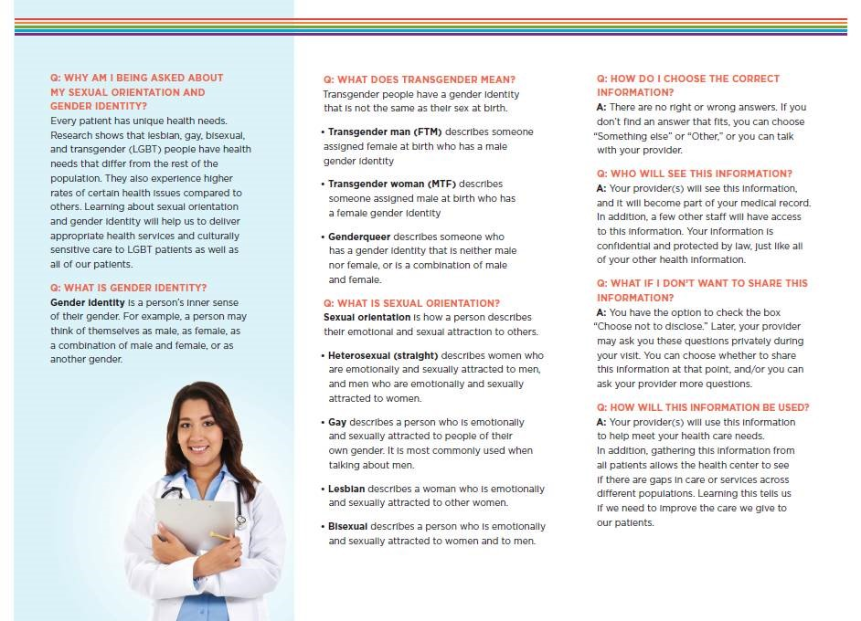
Providing Information to Patients

Slide 49
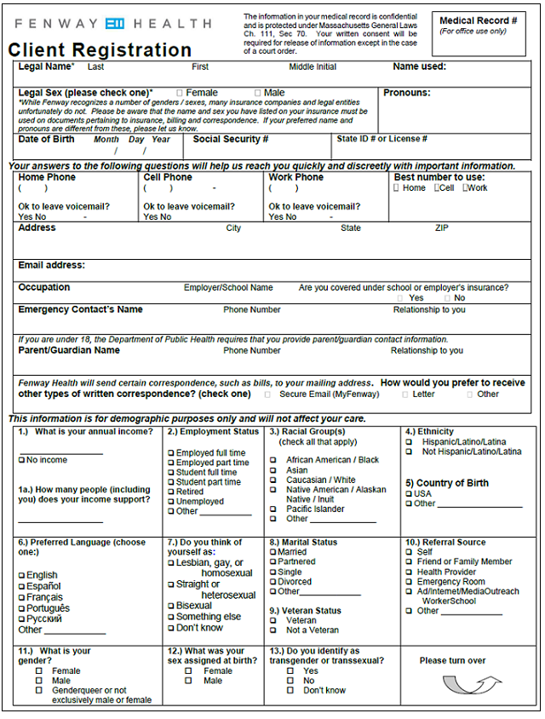
Sample Registration Intake Form
Legal Name
Name Used
Pronouns
Legal Sex
Parent/Guardian
Sexual Orientation
Gender Identity
Assigned Sex at Birth
Notes:
SOGI data collection is critical, and has to be done sensitively without assumptions, routinely on all, along with other demographic data.
Patients may feel safer discussing their health and risk behaviors once they’ve disclosed
Improve the patient experience and clinical outcomes
Many transgender patients may have identification documents and insurance forms that do not reflect their current name and gender identity
Some patients may have a non-binary gender identity and use pronouns such as “they” or “ze”, which may be unfamiliar to some providers
As part of registration intake forms, legal name, Name Used and pronouns, legal sex, sexual orientation, gender identity, and assigned sex at birth can be collected along with other demographic variables.

Slide 50
Privacy and Confidentiality
How do you keep SO/GI information private and confidential?
In the EHR?
Auditing
Patients have a right to know who has viewed their record
Some EHR’s allow for sensitivity tags or restrictions on who can view their records
In conversations?
HIPAA
In small communities?
Notes:
EHR auditing – (breach); can’t hide behind anything so if you go into a chart we will know
view someone’s chart and if you are in the chart inappropiately, we let staff know that this is a fireable offense.
Some EHR’s will allow for sensitive tags or restrictions on viewing if a patient feels particularly concerned
Tell staff that you may be in a situation where you have to check-in a friend or family member and we strongly discourage you from going into their EHR chart; is there someone else available who can do this
Although we are in a big city, we are in a small LGBT community; so there is definitely a chance of staff knowing someone who walks through our doors like a rural community
Emphasize with staff that for you this is a job but for patient’s this is personal

Slide 51
Managing Challenges and Problems
How do you respond to patients who do not want to disclose SO, GI, or sex assigned at birth?
Patients who have a primary language other than English or different cultural backgrounds?
What kinds of communication problems occur (e.g., misgendering/pronouns, etc.), and how do you deal with mistakes?
How else do you handle patient complaints?
e.g., working with transgender patient navigator, clinical staff
Notes:
Some of our lessons learned
By collecting sogi data, we can and want to know that LGBT people are experiencing the same level of patient satisfaction as other patients
Interpretative services – make sure they are aware and understand these
Perseverating on mistake may make us feel better but makes patient feel worse and more awkward and can be traumatic
With trans community, the biggest complaint is usually using the wrong name or pronoun

Slide 52
Managing Challenges and Problems (cont.)
What other problems should you anticipate and how do you deal with it? e.g.,
Patient’s name doesn’t match their insurance card
When a provider changes name/gender on EHR, and it does not match the insurance information?
Using the most updated registration form
Discard older versions
Keep a laminated copy in Patient Services Manual
How do you deal with searching for a patient in the EHR?
How do you check for quality/ and fix issues of the registration data?
Notes:
Assure patient that the name that they want to use will be used at our health center but for insurance purposes we will need their insurance name to prevent them from getting insurance denials
Don’t want to become a barrier to a patient care;
Provider can flag reg staff to let them know that their was a legal name/sex change on a patient’s chart
Searching – asking for additional information like date of birth

Slide 53
Pronoun Color Code
Female Pronouns, e.g. She/Her/Hers
Male Pronouns, e.g. He/Him/His
Non-binary Pronouns, e.g. They/Them/Their
Notes:
Color coding system for pronouns
When staff get the name and pronouns right then they feel good about the care they are providing too

Slide 54
Current Practice: CPS Registration Screen

Slide 55
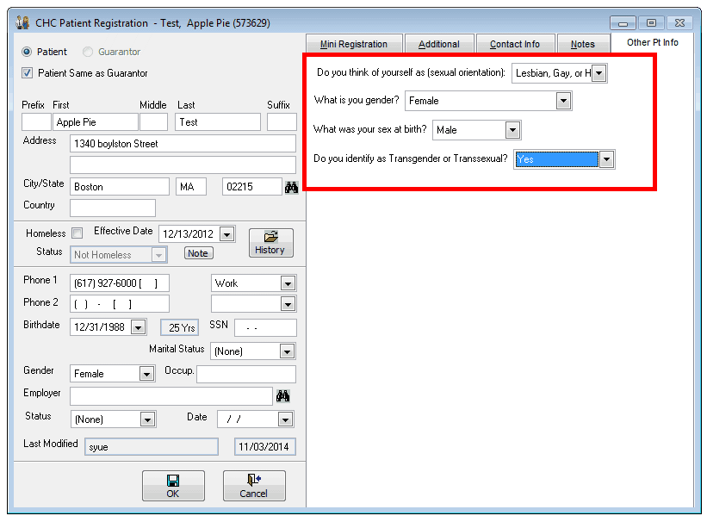
Current Practice Registration Screen
Notes:
Just like other information like (weight or height) we know that SOGI does not flow in a perfect line so want to be able to track over time which will enable you to look at patient clinical outcomes too
This is an example of a current practice registration screen based on Centricity Practice Solution/Visualution, which demonstrates the collection of sexual orientation and gender identity information as discrete data fields. This can be used as a model when collecting SOGI information during registration in other EHR software.

Slide 56
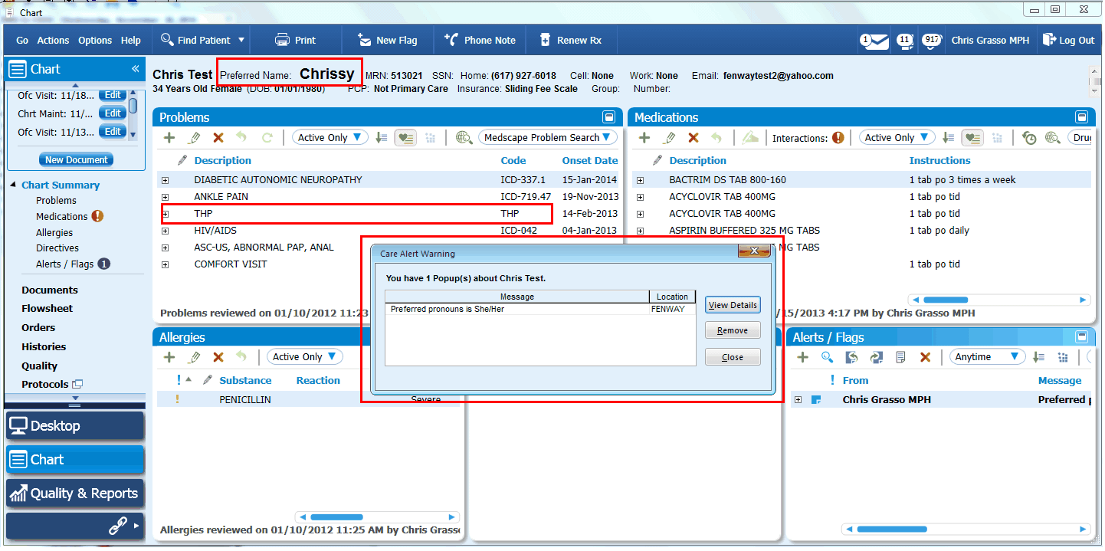
Current Practice: Modified Chart View
2
1
3
1
Notes:
When working with EHR vendors, the following changes can be made to EHR software when documenting SOGI information and preferred name and pronoun:
Name Used and pronouns can be entered, along with care alert warnings, and color-coded reminders
Name used appears as larger text
Transgender Health Program (THP) codes can be entered for transgender patients
Having these types of visual cues helps assist work flows in regards to communicating SOGI information among various staff members and patient care providers.

Slide 57
Additional Customizations
Custom Clinical Forms
All letter templates updated to exclude salutations (e.g. Mr., Miss, Ms.)
Changed to ‘Dear Fenway Patient’
Clinicians can still edit the letters as needed
Note: changes were made as legally permitted
Added name used to other documents such as:
Patient Instructions
Internal labels
Chart Summary
Bulk mailings are reviewed to determine the correct name
Consideration given to name patient uses outside of organization
Notes:
Many EHR vendors have letters or emails where the salutations are pre-populated (eg. Ms., Mr, etc) based on the ‘sex field’
We stripped this off and decided to use a generic ‘Dear Fenway Patient’

Slide 58
You’ve Built it Now What? Data Reporting and Quality Checks
Notes:
Its not enough to just collect the data w must use the data for population health management. In order to use the data, the data must be of good quality.

Slide 59
Data Integrity and Quality Checks
Validate – assessing the correctness and reasonableness of the data
Compare completed registration form against data entered in patient’s chart
Start with 100% QC
Taper off process as errors decrease but continue random checks
Completeness – no data or very little data
Compare and investigate missing values
How does completeness compare to other demographic data?
Errors of omission - Check if data are missing randomly or are localized in some way
Look for patterns of incorrect/incomplete/missing data by staff
Accuracy – check for abnormal values
Does the data make sense?
Outliers
Are the outliers legitimate or expected?
Are there response categories that don’t belong in that field?
For example: Sexual Orientation field has a response recorded as ‘Male to Female Transgender‘

Slide 60
Ongoing Monitoring: Beginning Not an Ending
System Glitches = Data Glitches
Are staff using the correct registration forms?
System issues external to the process
Is the EHR software installed and working correctly?
Run Regular Reports
Identify glitches
Look at trends over time
For example: Is there a sudden drop or spike?
Include in other quality reports and initiatives
For example: PCMH, Meaningful Use both monitor demographics – add SOGI as an internal part of the monitoring process
Ongoing Training for staff
Staff turnover
Incorporate into new staff orientation
Include as part of annual trainings

Slide 61
Quality Reports: Rates of Cervical Cancer Screening Among Patients By Sexual Orientation
 | Cervical Cancer Screen Completed?
Sexual Orientation | Yes (%) | No (%) | Total (%)
Lesbian/Gay
Bisexual
Straight/Heterosexual
Something Else
Don't Know
Missing
Total

Slide 62
?

